Slide 1
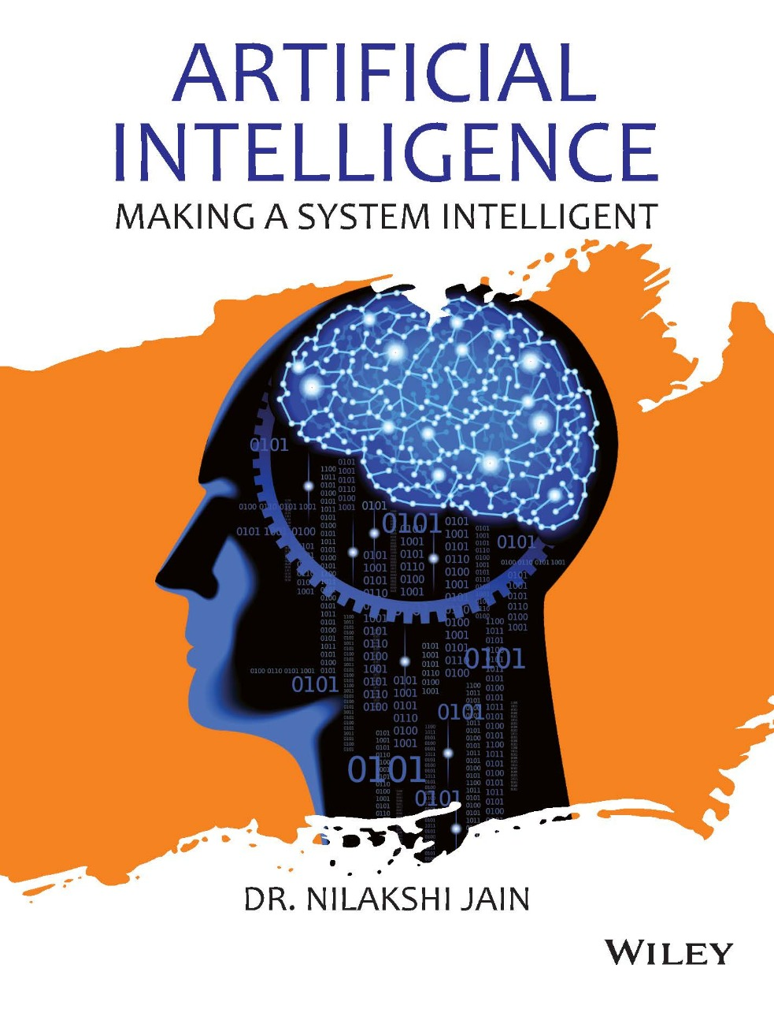
Chapter One
Introduction to Artificial Intelligence

Slide 2
1.1 Introduction 1.2 What is AI? 1.3 What is Problem? 1.4 What is a solution? 1.5 Types of Problem and Solution 1.6 Definitions of AI 1.7 Goals of AI 1.8 History of AI 1.9 Branches or sub-area of AI 1.10 Applications of AI 1.11 Categorization of AI 1.12 Components of AI 1.13 Trends in AI 1.14 AI Programming languages
Learning Objectives
After reading this chapter, students would be able to:
• Understand the concept of Artificial Intelligence and its effect on prevalent technologies.
• Interpret and apply solution based on the type of problems.
• Develop a general appreciation of the goals, subareas, achievements, and difficulties of Artificial Intelligence.

Slide 3
1.1 Introduction 1.2 What is AI? 1.3 What is Problem? 1.4 What is a solution? 1.5 Types of Problem and Solution 1.6 Definitions of AI 1.7 Goals of AI 1.8 History of AI 1.9 Branches of AI 1.10 Applications of AI 1.11 Categorization of AI 1.12 Components of AI 1.13 Trends in AI 1.14 AI Programming languages
Introduction
In Information Communication Technology, AI has done some amazing changes which we didn’t even think of. Nearly everywhere we look today, we see intelligent systems talking to us like “Hello .......Siri :)” or offering recommendations through Netflix and Amazon or by providing financial advice by Schwab’s Intelligent Portfolio, even for winning game shows IBM’s Watson helps and more interesting is watching sci-fi movies which uses AI. AI can be defined as an approach of creating an automatic robot, or a system, or a software, having intelligence same as humans and perform task with the same efficiency as human do.
But in order to classify machine as “having its own intelligence,” first we should understand the concept of Intelligence.

Slide 4
1.1 Introduction 1.2 What is AI? 1.3 What is Problem? 1.4 What is a solution? 1.5 Types of Problem and Solution 1.6 Definitions of AI 1.7 Goals of AI 1.8 History of AI 1.9 Branches of AI 1.10 Applications of AI 1.11 Categorization of AI 1.12 Components of AI 1.13 Trends in AI 1.14 AI Programming languages
Intelligence
Intelligence is the process or a part of the power to attain goals within the world. Different types and degrees of intelligence occur in folks (people), several animals, and a few machines. Intelligence is employed to resolve issues or solve problems.

Slide 5
1.1 Introduction 1.2 What is AI? 1.3 What is Problem? 1.4 What is a solution? 1.5 Types of Problem and Solution 1.6 Definitions of AI 1.7 Goals of AI 1.8 History of AI 1.9 Branches or sub-area of AI 1.10 Applications of AI 1.11 Categorization of AI 1.12 Components of AI 1.13 Trends in AI 1.14 AI Programming languages
What is Problem?
In general, a problem is an obstacle that makes it troublesome/difficult to attain a desired goal, objective, or purpose. It refers to a state of affairs, condition, or issue that is however unresolved. In an exceedingly broader sense, a problem exists once an individual become tuned in to important distinction between what really is and what is desired. Each problem has an answer or solution.
What is a Solution?
A procedure that makes the problem navigation towards the goal is called solution. It can be algorithm or a hard-core implementation to achieve the goal defined by the problem.

Slide 6
1.1 Introduction 1.2 What is AI? 1.3 What is Problem? 1.4 What is a solution? 1.5 Types of Problem and Solution 1.6 Definitions of AI 1.7 Goals of AI 1.8 History of AI 1.9 Branches or sub-area of AI 1.10 Applications of AI 1.11 Categorization of AI 1.12 Components of AI 1.13 Trends in AI 1.14 AI Programming languages
Depending on the way in which the problems are solved, problems are classified into the following types:
1. Structured problem
2. Unstructured problem
Cont….
Types of Problem and Solution

Slide 7
1.1 Introduction 1.2 What is AI? 1.3 What is Problem? 1.4 What is a solution? 1.5 Types of Problem and Solution 1.6 Definitions of AI 1.7 Goals of AI 1.8 History of AI 1.9 Branches or sub-area of AI 1.10 Applications of AI 1.11 Categorization of AI 1.12 Components of AI 1.13 Trends in AI 1.14 AI Programming languages
Structured problem
Structural problems are the ones for which there exists a specific algorithm to achieve the goal. The same algorithm is run against variety input data still giving a guarantee of the problem being solved. Since the structure of the solution (that is in the algorithm) remains the same, even if the input data changes, these problems are called structured problems.
For example-
To sort the students according to their total marks, the details about the students may be stored in the database, the sort algorithm will then get the details of students from the database and will solve the problem.
Cont….

Slide 8
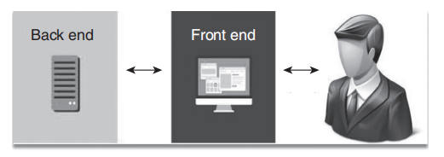
1.1 Introduction 1.2 What is AI? 1.3 What is Problem? 1.4 What is a solution? 1.5 Types of Problem and Solution 1.6 Definitions of AI 1.7 Goals of AI 1.8 History of AI 1.9 Branches or sub-area of AI 1.10 Applications of AI 1.11 Categorization of AI 1.12 Components of AI 1.13 Trends in AI 1.14 AI Programming languages
Back end: Backend is a unit which can store data in static fashion. Static data is nothing but a fact (e.g., a backend can be a database system or a file system).
Front end: Front end is a unit that provides user interface and performs the complete business logic. It can be a program written in any programming language, such as C, C++, Java, etc. As a result, a user interacts with the front end of the system to access the backend.
Cont….
General solution structured problem

Slide 9
1.1 Introduction 1.2 What is AI? 1.3 What is Problem? 1.4 What is a solution? 1.5 Types of Problem and Solution 1.6 Definitions of AI 1.7 Goals of AI 1.8 History of AI 1.9 Branches or sub-area of AI 1.10 Applications of AI 1.11 Categorization of AI 1.12 Components of AI 1.13 Trends in AI 1.14 AI Programming languages
Unstructured problem
Unstructured problems are the problems for which there does not exist a specific algorithm to achieve the goal. What step to take to achieve the goal depends on what is the current state of the problem. AI is an attempt to make a computer to solve unstructured problems.
For example-
A problem of playing chess or a problem to write a program to perform heart surgery, etc., are unstructured problems, because there does not exist any specific algorithm to solve it. Such problems are solved using a Knowledge Base
Cont….

Slide 10
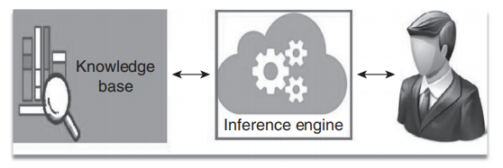
1.1 Introduction 1.2 What is AI? 1.3 What is Problem? 1.4 What is a solution? 1.5 Types of Problem and Solution 1.6 Definitions of AI 1.7 Goals of AI 1.8 History of AI 1.9 Branches or sub-area of AI 1.10 Applications of AI 1.11 Categorization of AI 1.12 Components of AI 1.13 Trends in AI 1.14 AI Programming languages
A general solution to an unstructured problem
Knowledge base: It is the collection of facts (static data) as well as rules. Unlike database, Knowledge Base does not store only static data.
Inference engine: It is used to prove a goal (new fact) from the given facts and rules in the knowledge base.

Slide 11
1.1 Introduction 1.2 What is AI? 1.3 What is Problem? 1.4 What is a solution? 1.5 Types of Problem and Solution 1.6 Definitions of AI 1.7 Goals of AI 1.8 History of AI 1.9 Branches or sub-area of AI 1.10 Applications of AI 1.11 Categorization of AI 1.12 Components of AI 1.13 Trends in AI 1.14 AI Programming languages
According to the father of Artificial Intelligence, John McCarthy, AI is The science and engineering of making intelligent machines, especially intelligent programs.
The study of mental facilities through the use of computational models. -Charniak and McDermott, 1985
The scientific understanding of the mechanisms underlying thought and their intelligent behavior and their embodiment in machines. -American Association of Artificial Intelligent (AAAI)
Cont….

Slide 12
1.1 Introduction 1.2 What is AI? 1.3 What is Problem? 1.4 What is a solution? 1.5 Types of Problem and Solution 1.6 Definitions of AI 1.7 Goals of AI 1.8 History of AI 1.9 Branches or sub-area of AI 1.10 Applications of AI 1.11 Categorization of AI 1.12 Components of AI 1.13 Trends in AI 1.14 AI Programming languages
Some definitions measure success in terms of human performance, whereas some measure against ideal concept of intelligence, that is, rationality.
A system is rational if it does right things. This gives four possible goals to peruse AI:
1. System that reasons (thinks) like human
2. System that reasons (thinks) rationally
3. System that acts like human
4. System that acts rationally

Slide 13
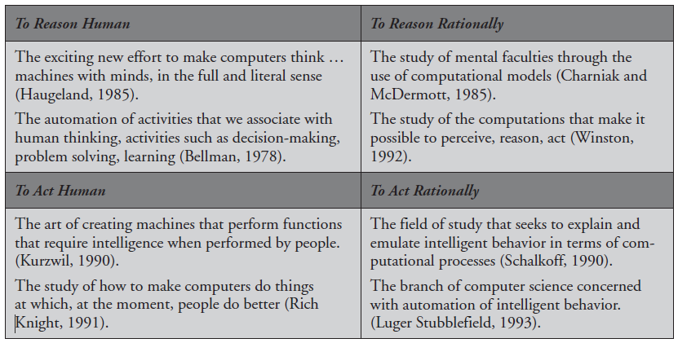
1.1 Introduction 1.2 What is AI? 1.3 What is Problem? 1.4 What is a solution? 1.5 Types of Problem and Solution 1.6 Definitions of AI 1.7 Goals of AI 1.8 History of AI 1.9 Branches or sub-area of AI 1.10 Applications of AI 1.11 Categorization of AI 1.12 Components of AI 1.13 Trends in AI 1.14 AI Programming languages

Slide 14
1.1 Introduction 1.2 What is AI? 1.3 What is Problem? 1.4 What is a solution? 1.5 Types of Problem and Solution 1.6 Definitions of AI 1.7 Goals of AI 1.8 History of AI 1.9 Branches or sub-area of AI 1.10 Applications of AI 1.11 Categorization of AI 1.12 Components of AI 1.13 Trends in AI 1.14 AI Programming languages
Scientific goal
Scientific goal is to determine which ideas about knowledge representation, learning, rule systems, search, and so on, explain various sorts of real intelligence (e.g., implementation of Expert Systems which exhibit intelligent behavior, learn, demonstrate, explain, and advice its users).
Engineering goal
Engineering goal is to solve real-world problems by using AI techniques, such as knowledge representation, learning, rule systems, search, and so on. For example, implementation of Human Intelligence in Machines, which means creating systems that understand, think, learn, and behave like humans.

Slide 15
1.1 Introduction 1.2 What is AI? 1.3 What is Problem? 1.4 What is a solution? 1.5 Types of Problem and Solution 1.6 Definitions of AI 1.7 Goals of AI 1.8 History of AI 1.9 Branches or sub-area of AI 1.10 Applications of AI 1.11 Categorization of AI 1.12 Components of AI 1.13 Trends in AI 1.14 AI Programming languages
History of AI can be explained mainly in six groups
1. Beginning: 1943–1952
2. 1952–1969: Early enthusiasm, high hopes – ELIZA chatterbot
3. 1952–1969: Sobering up
4. 1970–1979: Knowledge-based systems
5. 1980–2010: (AI becomes an industry – era of Intelligent Agents, Machine Learning, Robotics)
6. 2010–till date: (era of Deep Learning)

Slide 16
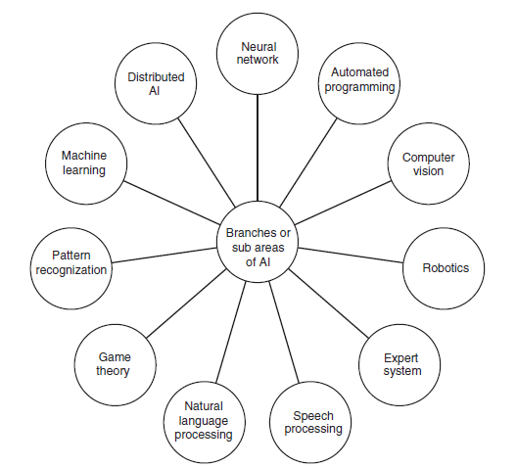
1.1 Introduction 1.2 What is AI? 1.3 What is Problem? 1.4 What is a solution? 1.5 Types of Problem and Solution 1.6 Definitions of AI 1.7 Goals of AI 1.8 History of AI 1.9 Branches or sub-area of AI 1.10 Applications of AI 1.11 Categorization of AI 1.12 Components of AI 1.13 Trends in AI 1.14 AI Programming languages
Branches or sub-area of AI

Slide 17
1.1 Introduction 1.2 What is AI? 1.3 What is Problem? 1.4 What is a solution? 1.5 Types of Problem and Solution 1.6 Definitions of AI 1.7 Goals of AI 1.8 History of AI 1.9 Branches or sub-area of AI 1.10 Applications of AI 1.11 Categorization of AI 1.12 Components of AI 1.13 Trends in AI 1.14 AI Programming languages
Applications of AI
Game playing
Mathematics
Autonomous control
Diagnosis
Logistics planning
Autonomous planning and scheduling
Language understanding and problem solving
Robotics
Natural Language Generation
Speech recognition
Virtual agents
Text analytics and NLP
Robotic process automation
Biometrics
Deep learning platforms
Decision management
AI-optimized hardware
Machine-learning platforms

Slide 18
1.1 Introduction 1.2 What is AI? 1.3 What is Problem? 1.4 What is a solution? 1.5 Types of Problem and Solution 1.6 Definitions of AI 1.7 Goals of AI 1.8 History of AI 1.9 Branches or sub-area of AI 1.10 Applications of AI 1.11 Categorization of AI 1.12 Components of AI 1.13 Trends in AI 1.14 AI Programming languages
Categorization of AI
1. Sensing - Through the sensor taking in data about the world which includes: In speech recognition filtering out the noise and then recognizing specific words from the input speech. Some examples of other sensors are robotics, sonar, accelerometers, balance detection, etc.
2. Reasoning- Reasoning is thinking or process the data sensed by the sensor. In logic-based inference, reasoning is deciding that something is true because, logically, it must be true. In evidence-based inference, reasoning is deciding that something is true based on the weight of evidence at hand.
3. Acting- On the basis of input and reasoning, acting is generating and controlling actions in the environment. In robotic control, action is moving and managing the different effectors that move you about the world.

Slide 19
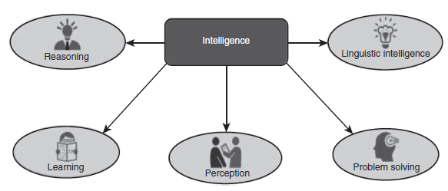
1.1 Introduction 1.2 What is AI? 1.3 What is Problem? 1.4 What is a solution? 1.5 Types of Problem and Solution 1.6 Definitions of AI 1.7 Goals of AI 1.8 History of AI 1.9 Branches or sub-area of AI 1.10 Applications of AI 1.11 Categorization of AI 1.12 Components of AI 1.13 Trends in AI 1.14 AI Programming languages
Components of AI
In AI, the intelligence is intangible which is composed of mainly five techniques as follows
Reasoning
Learning
Problem solving
Perception
Linguistic intelligence

Slide 20
1.1 Introduction 1.2 What is AI? 1.3 What is Problem? 1.4 What is a solution? 1.5 Types of Problem and Solution 1.6 Definitions of AI 1.7 Goals of AI 1.8 History of AI 1.9 Branches or sub-area of AI 1.10 Applications of AI 1.11 Categorization of AI 1.12 Components of AI 1.13 Trends in AI 1.14 AI Programming languages
Components of AI
1. Reasoning- Reasoning is the set of processes that enables an intelligent system to help or to provide basis for actions, making decisions, and prediction. Reasoning is of two types: Inductive Reasoning and Deductive Reasoning.
2. Learning- Learning is the process of gaining knowledge by understanding, practicing, being taught, or experiencing one thing. Learning enhances the awareness of any topic.
3. Problem solving- Problem solving is the method during which one perceives and tries to make a desired answer from a present state of affairs by taking some path, that is blocked by known or unknown hurdles.
Cont….

Slide 21
1.1 Introduction 1.2 What is AI? 1.3 What is Problem? 1.4 What is a solution? 1.5 Types of Problem and Solution 1.6 Definitions of AI 1.7 Goals of AI 1.8 History of AI 1.9 Branches or sub-area of AI 1.10 Applications of AI 1.11 Categorization of AI 1.12 Components of AI 1.13 Trends in AI 1.14 AI Programming languages
Components of AI
4. Perception- Perception is the method of acquiring, decoding, selecting, and organizing sensory data. Perception presumes sensing. Within the domain of AI, perception mechanism puts the info acquired by the sensors along in a very meaningful manner.
5. Linguistic intelligence- Linguistic intelligence is one’s ability to use, comprehend, speak, and write the verbal and written language. It is important in interpersonal communication.

Slide 22
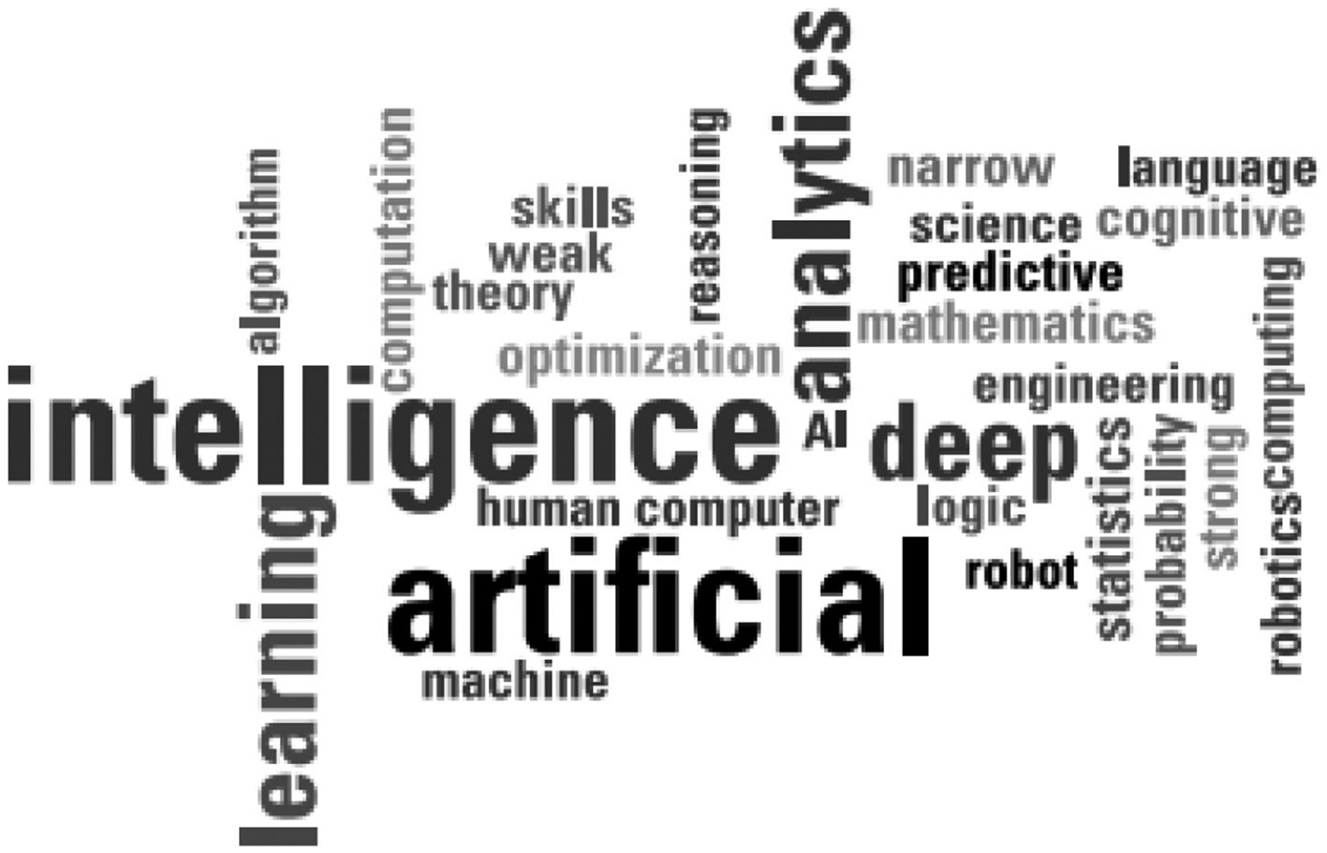
One name “Artificial Intelligence” for many trends.
1.1 Introduction 1.2 What is AI? 1.3 What is Problem? 1.4 What is a solution? 1.5 Types of Problem and Solution 1.6 Definitions of AI 1.7 Goals of AI 1.8 History of AI 1.9 Branches or sub-area of AI 1.10 Applications of AI 1.11 Categorization of AI 1.12 Components of AI 1.13 Trends in AI 1.14 AI Programming languages

Slide 23
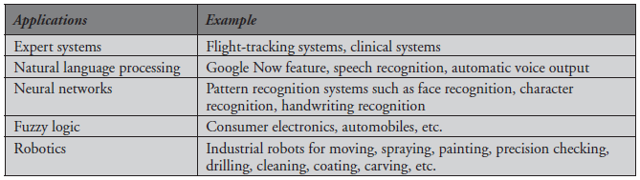
Trends in AI
There is a large array of applications where AI is serving common people in their day-to-day lives which can be grouped into the following categories.
1.1 Introduction 1.2 What is AI? 1.3 What is Problem? 1.4 What is a solution? 1.5 Types of Problem and Solution 1.6 Definitions of AI 1.7 Goals of AI 1.8 History of AI 1.9 Branches or sub-area of AI 1.10 Applications of AI 1.11 Categorization of AI 1.12 Components of AI 1.13 Trends in AI 1.14 AI Programming languages

Slide 24
AI Programming languages
AI could be a branch of engineering, which essentially aims for creating computers which may think intelligently in a similar manner the intelligent humans think (Using these programming languages, various AI problems have been solved as shown in Appendix A Lab Experiments).
A number of programming languages exist that are used to build AI systems. General programming languages, such as C++, R, Java, Python, and LISP (List Processing) are frequently used, because these are the languages with which most computer scientists have got experience.
Here are some languages that are most typically used for creating the AI projects:
PROLOG
LISP
R
Python
Java
C++
1.1 Introduction 1.2 What is AI? 1.3 What is Problem? 1.4 What is a solution? 1.5 Types of Problem and Solution 1.6 Definitions of AI 1.7 Goals of AI 1.8 History of AI 1.9 Branches or sub-area of AI 1.10 Applications of AI 1.11 Categorization of AI 1.12 Components of AI 1.13 Trends in AI 1.14 AI Programming languages

Slide 25
Dr. Nilakshi Jain Email ID : nilakshijain1986@gmail.com
Thank you

